Slide 1
Modeling Air Travel Choice Behavior with Mixed Kernel Density Estimations
Sourse: WSDM 2017
Advisor: Jia-Ling Koh
Speaker: Hsiu-Yi,Chu
Date: 2017/9/26

Slide 2
Outline
Introduction
Method
Experiment
Conclusion

Slide 3
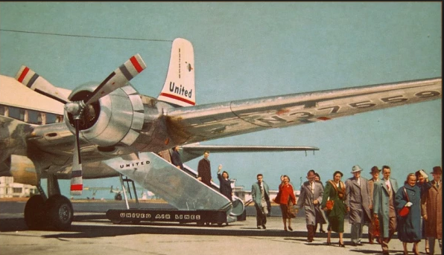
Introduction
Air Travel Choice Behavior. Ex : airline, takeoff time, arrive time

Slide 4
Introduction
Problem description
  Definition(Personalized air travel choice behavior modeling problem)
  x=(x1,x2,‧‧‧,xm)
    Goal ➔ probability density model
    {Frank(id),經濟艙(座位),工作天(日子類型),······}➔?%

Slide 5
Introduction
Framework
Problem descript-tion
Feature extraction
Individual level air travel choice behavior model
Mixture models
(sparsity problem)
Model training

Slide 6
Outline
Introduction
Method
Experiment
Conclusion

Slide 7
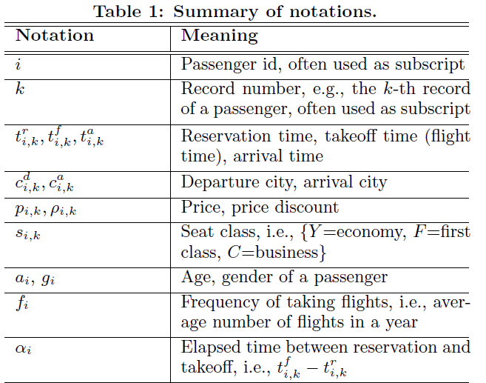
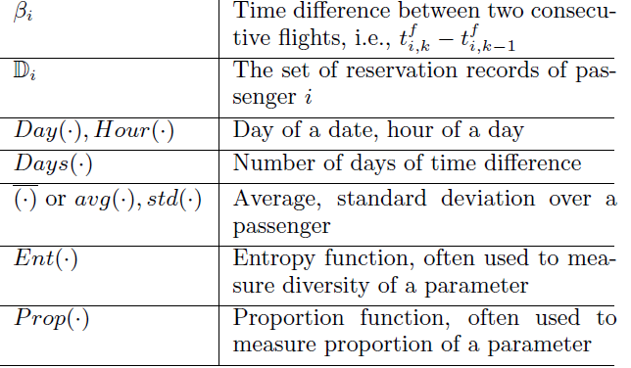
Method
Air travel choice behavior modeling problem

Slide 8
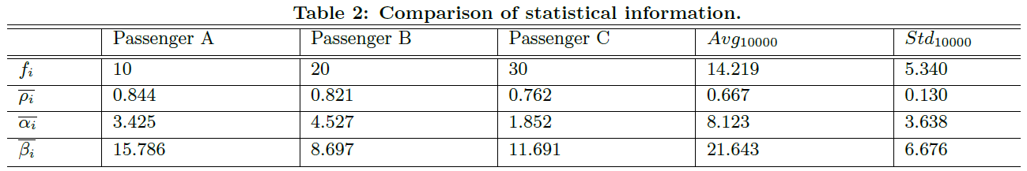
Method
Heterogeneous air travel choice behaviors

Slide 9
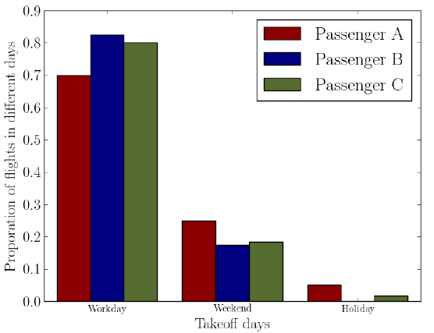
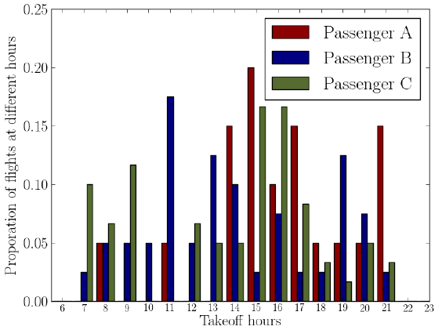
Method
Heterogeneous air travel choice behaviors

Slide 10
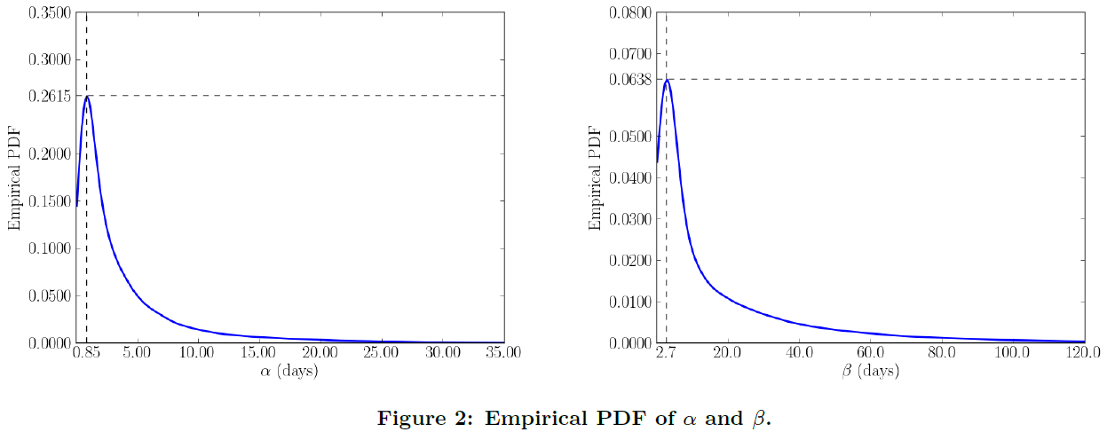
Method
Feature extraction
  Reservation factors(α,β)

Slide 11
Method
  Flight factors(takeoff day, price discount)

Slide 12
Method
  Passenger factors(age, gender)

Slide 13
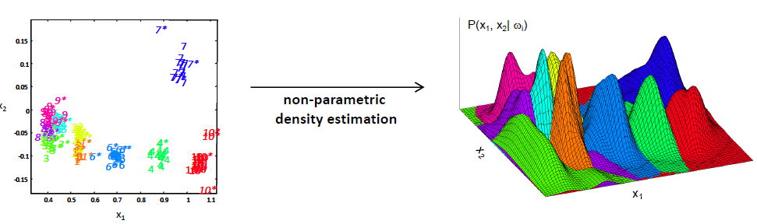
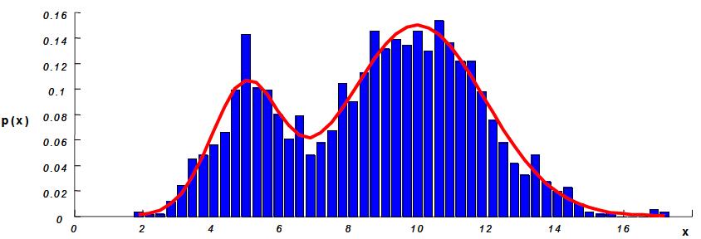
Method
  Non-parametric density estimation
  histogram

Slide 14
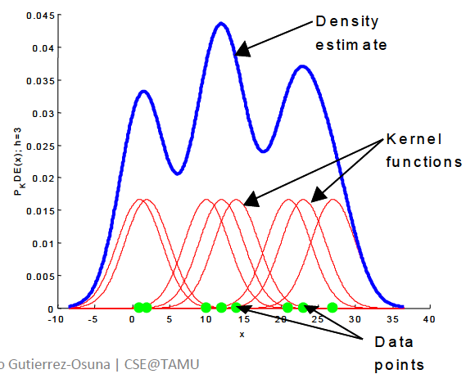
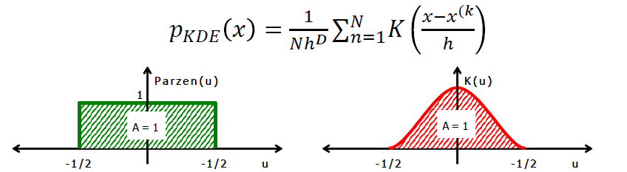

Method
  Smooth kernels

Slide 15



Method
Individual level air travel choice behavior model
  Kernel density estimation
  Bandwidth selection ➔ cross validation

Slide 16
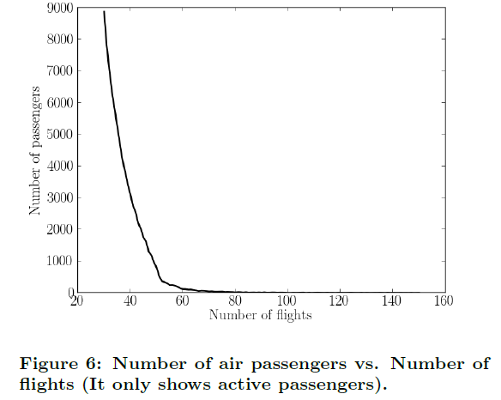
Method
Sparsity problem

Slide 17
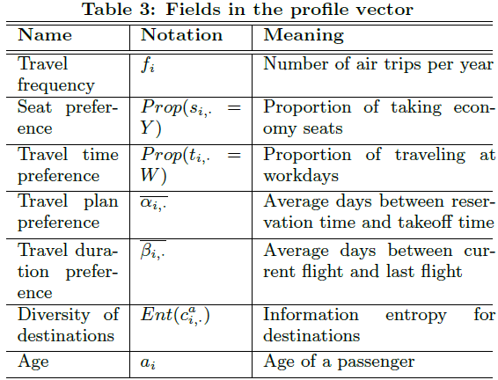
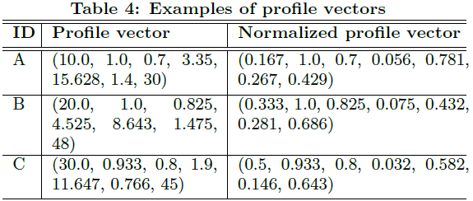
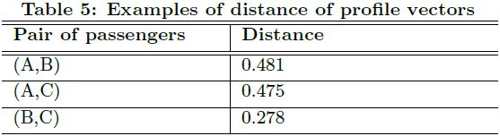
Method
Measuring difference between passengers

Slide 18
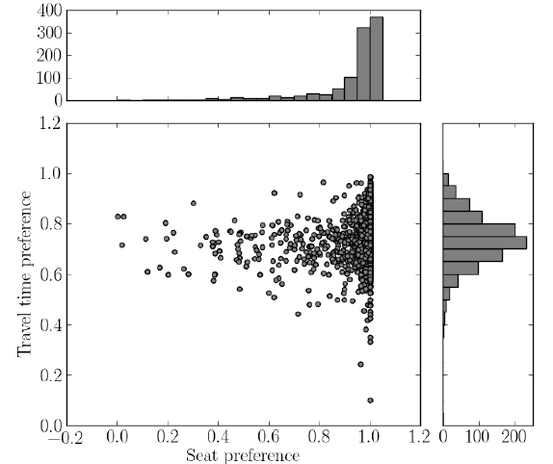
Method
Measuring difference between passengers

Slide 19


Method
Mixture models
  Component
    2-component
    3-component

Slide 20
Method
Model training
  EM 演算法
假設我們現在有a,b兩個參數，在開始的時候兩者都是未知的，並且知道了a的值就可以反推b的值，反過來也是一樣的。所以可以考慮首先賦予a某一個初值，以此得到b的估計值，然後從b的當前值出發，重新估計a的值，這個過程會一直持續到收斂為止。

Slide 21
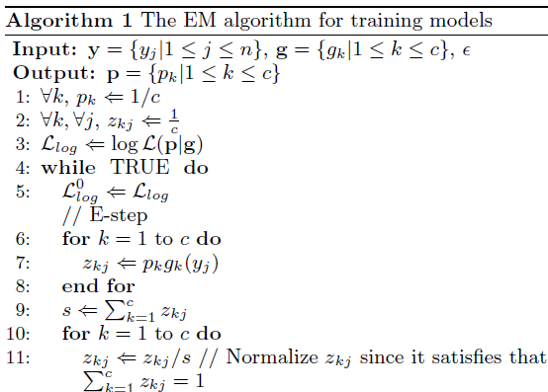
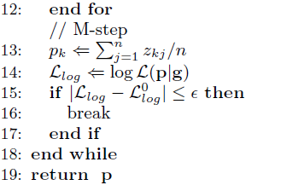
Method
Model training

Slide 22
Outline
Introduction
Method
Experiment
Conclusion

Slide 23
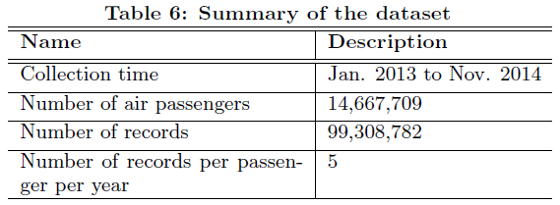
Experiment
Dataset

Slide 24

Experiment
Evaluated models
  GMM: Gaussian mixture model
  fKDE: fixed-bandwidth kernel density estimation
  Mix-KDE
Definition(Likelihood)

Slide 25
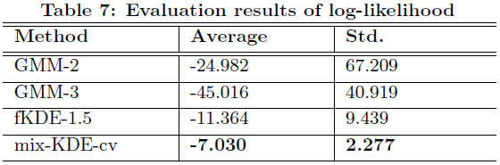
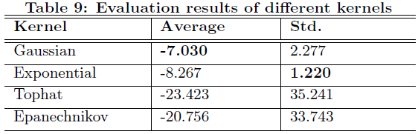
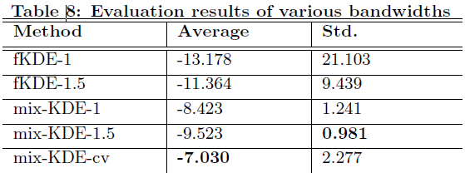
Experiment
Evaluation result

Slide 26
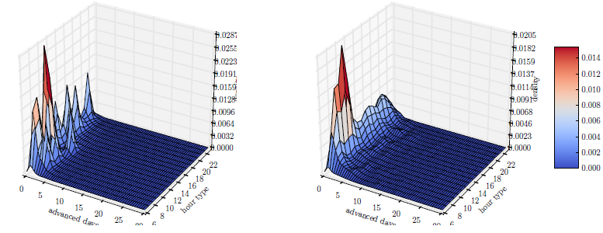
Experiment
Visualization

Slide 27
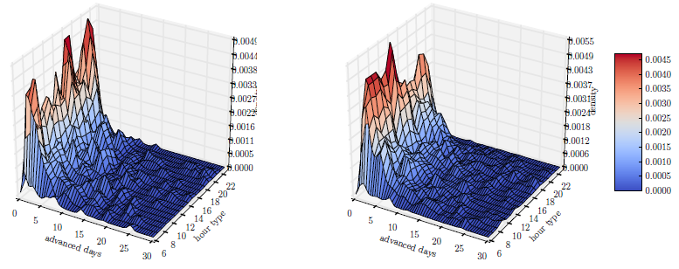
Experiment
Visualization

Slide 28
Outline
Introduction
Method
Experiment
Conclusion

Slide 29
Conclusion
We have studied the problem of modeling the air travel choice behavior.
We apply the kernel density estimation for individual-level modeling.
Mix-KDE approach is proposed in order to tackle the data sparsity problem.

